Slide 1
Usage Funnels
Analyze Data with SQL
Mohammed Jarada
16/07/2020

Slide 2
Table of Contents
Warby Parker is a transformative lifestyle brand with a lofty objective: to offer designer eyewear at a revolutionary price while leading the way for socially conscious businesses.
In this project, I will analyse different Warby Parker’s marketing funnels in order to calculate conversion rates. Here are the funnels and the tables:
Quiz Funnel:
survey
Home Try-On Funnel:
quiz
home_try_on
purchase

Slide 3
1. Quiz Funnel

Slide 4
1.1 Quiz Funnel
The quiz funnel includes only one table: survey, which includes the users’ responses to 5 questions to help them find their perfect frame.
What is the number of responses for each question?
Which question(s) of the quiz have lower completion rates?
Let’s analyse the table “survey”:
-- Selecting all columns from the first 10 rows
SELECT *
FROM survey
LIMIT 10;
-- Let’s analyse how many users move from Question 1 to Question 2, etc
SELECT question, count(distinct user_id) AS Count
FROM survey
GROUP by 1
ORDER by 1;
question | Count | Percentage
1. What are you looking for? | 500 | 100.00%
2. What's your fit? | 475 | 95.00%
3. Which shapes do you like? | 380 | 80.00%
4. Which colors do you like? | 361 | 95.00%
5. When was your last eye exam? | 270 | 74.79%
Using Excel to analyse the query results, we can see that Question 3 and Question 5 have lower completion rates.

Slide 5
2. Home Try-On Funnel

Slide 6
2.1 Home Try-On Funnel
The data will be distributed across three tables:
quiz
home_try_on
purchase
Let’s find out whether or not users who get more pairs to try on at home will be more likely to make a purchase.
-- First we need to combine all three tables
SELECT *
FROM quiz AS q
LEFT JOIN home_try_on AS h on h.user_id = q.user_id
LEFT JOIN purchase AS p on p.user_id = h.user_id;
-- Let's add two columns (is_home_try_on)and (is_purhcase). We use this to identify which users didn't home try on or purchase.
-- I will use NOT NULL to convert all values to 1 or 0 to identify which users bought glasses or didn’t.
SELECT DISTINCT q.user_id
,h.user_id IS NOT NULL AS 'is_home_try_on'
,h.number_of_pairs
,p.user_id IS NOT NULL AS 'is_purchase'
FROM quiz AS q
LEFT JOIN home_try_on AS h
on h.user_id = q.user_id
LEFT JOIN purchase AS p
on p.user_id = h.user_id
user_id | is_home_try_on | number_of_pairs | is_purchase
4e8118dc-bb3d-49bf-85fc-cca8d83232ac | 1 | 3 pairs | 0
291f1cca-e507-48be-b063-002b14906468 | 1 | 3 pairs | 1
75122300-0736-4087-b6d8-c0c5373a1a04 | 0 | null | 0
75bc6ebd-40cd-4e1d-a301-27ddd93b12e2 | 1 | 5 pairs | 0
5a7a7e13-fbcf-46e4-9093-79799649d6c5 | 0 | null | 0

Slide 7
2.2 Home Try-On Funnel
-- Lets' see how many people tried 3 pairs vs 5 pairs. I will use a common expression.
WITH funnels AS (SELECT DISTINCT q.user_id
,h.user_id IS NOT NULL AS 'is_home_try_on'
,h.number_of_pairs
,p.user_id IS NOT NULL AS 'is_purchase'
FROM quiz AS q
LEFT JOIN home_try_on AS h
on h.user_id = q.user_id
LEFT JOIN purchase AS p
on p.user_id = h.user_id)
select number_of_pairs, count(user_id) AS 'number of customers'
from funnels
where number_of_pairs IS NOT NULL
group by 1;
-- Let's calculate the difference in purchase rates between customers who had 3 number_of_pairs with ones who had 5.
WITH funnels AS (SELECT DISTINCT q.user_id
,h.user_id IS NOT NULL AS 'is_home_try_on'
,h.number_of_pairs
,p.user_id IS NOT NULL AS 'is_purchase'
FROM quiz AS q
LEFT JOIN home_try_on AS h
on h.user_id = q.user_id
LEFT JOIN purchase AS p
on p.user_id = h.user_id)
select number_of_pairs, count(user_id) as 'number of purchases'
from funnels
-- I will add a condition to show only customers who have purchased glasses
where is_purchase = 1
group by 1;
Number_of_pairs | Number of customers
3 pairs | 379
5 pairs | 371
Number of pairs | Number of customers | Number of purchases | Percentage
3 pairs | 379 | 201 | 53%
5 pairs | 371 | 294 | 79%
As we can see, users who received 5 pairs of glasses for a home try-on were more likely to make a purchase.

Slide 8
3. Other calculations

Slide 9
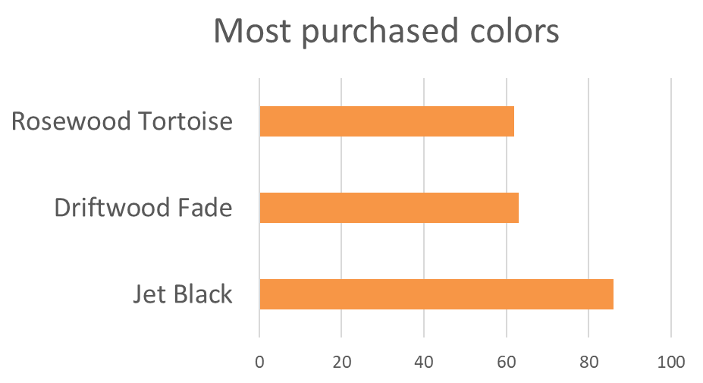
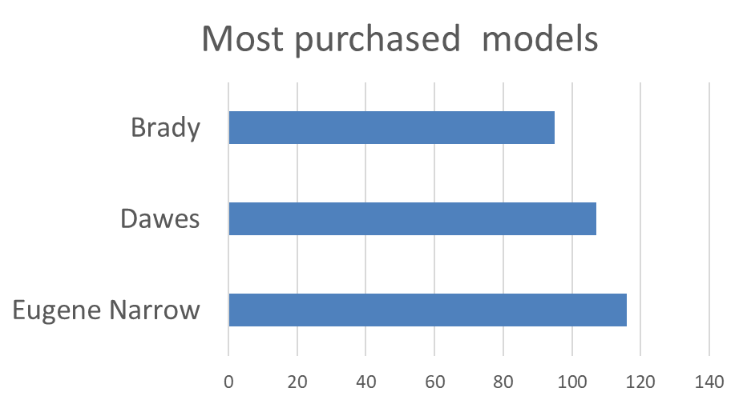
-- Popular shapes as per the survey
SELECT DISTINCT(response) AS 'preferred_shape',
COUNT(*) AS 'count_per_shape'
FROM survey
WHERE question LIKE '%shapes%'
GROUP BY response
ORDER BY 2 DESC;
-- 3 most popular colors
SELECT DISTINCT color,
COUNT(*) AS 'purchases_per_color'
FROM purchase
GROUP BY 1
ORDER BY 2 DESC
LIMIT 3;
-- 3 most popular models
SELECT DISTINCT model_name AS 'model',
COUNT(*) AS 'purchases_per_model'
FROM purchase
GROUP BY 1
ORDER BY 2 DESC
LIMIT 3;

Slide 10
For calculations and SQL code please check my GitHub:
https://github.com/mjarada37/MJarada-GitHub

